Slide 1
Advanced Artificial Intelligence
Week # 8
Dr. Qurat Ul Ain
Assistant Professor Dept. of AI & DS
FAST NUCES, Islamabad
Email: quratul.ain@isb.nu.edu.pk

Slide 2
Today
We are back to supervised learning
We are given training data {(x , t)}
We will look at classification, so t^{(i )} will represent the class label
We will focus on binary classification (two classes)
We will consider a linear classifier first (next class non-linear decision boundaries)

Slide 3
Support Vector Machine History
SVM is related to statistical learning theory
SVM was first introduced in 1992
SVM becomes popular because of its success in handwritten digit recognition
1.1% test error rate for SVM. This is the same as the error rates of a carefully constructed neural network, LeNet 4.
SVM is now regarded as an important example of “kernel methods”, one of the key area in machine learning
Notes:
First introduced in COLT-92 by Boser, Guyon and Vapnik
COLT = computational learning theory
B. Scholkopf et al. ICANN 96. 47-52.

Slide 4
Key Ideas
Two independent developments within last decade
New efficient separability of non-linear regions that use “kernel functions” : generalization of ‘similarity’ to new kinds
Use of quadratic optimization problem to avoid ‘local minimum’ issues with neural nets
The resulting learning algorithm is an optimization algorithm rather than a greedy search

Slide 5
Organization
Basic idea of support vector machines: just like 1- layer or multi-layer neural nets
Optimal hyperplane for linearly separable patterns
Extend to patterns that are not linearly separable by transformations of original data to map into new space – the Kernel function
SVM algorithm for pattern recognition

Slide 6
Support Vectors
Support vectors are the data points that lie closest to the decision surface (or hyperplane)
They are the data points most difficult to classify
They have direct bearing on the optimum location of the decision surface
We can show that the optimal hyperplane stems from the function class with the lowest “capacity”= # of independent features/parameters

Slide 7
Support Vector Machine
“Support Vector Machine” (SVM) is a supervised machine learning algorithm that can be used for both classification or regression challenges.
In the SVM algorithm, we plot each data item as a point in n-dimensional space (where n is a number of features you have) with the value of each feature being the value of a particular coordinate.
Then, we perform classification by finding the hyper-plane that differentiates the two classes very well
Support Vectors are simply the coordinates of individual observation. The SVM classifier is a frontier that best segregates the two classes (hyper-plane/ line).

Slide 8
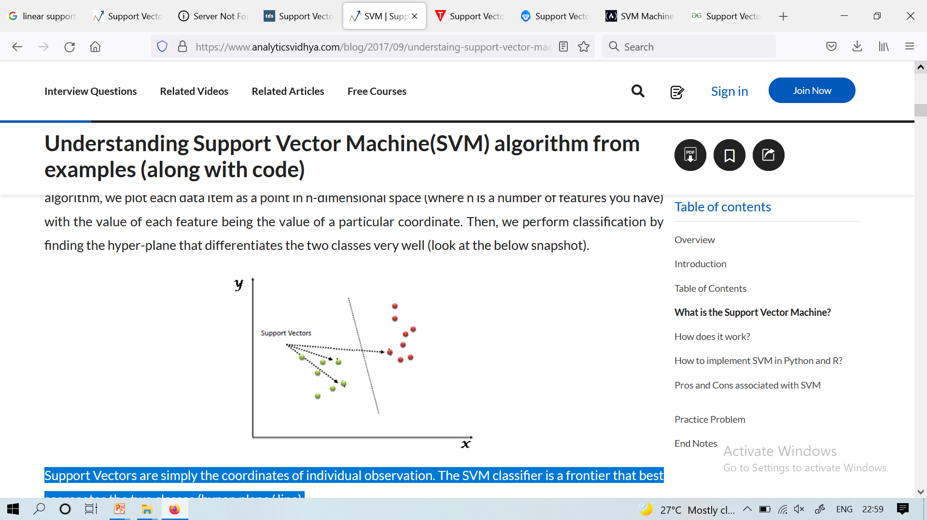
Support Vector Machine
Note: Don’t get confused between SVM and logistic regression. Both the algorithms try to find the best hyperplane, but the main difference is logistic regression is a probabilistic approach whereas support vector machine is based on statistical approaches.
Notes:
1. Logistic Regression: Probabilistic Approach
What does it do?
It calculates the probability that a given data point belongs to a certain class.
The output is a probability (between 0 and 1), and you set a threshold (like 0.5) to classify the data.
How does it find the hyperplane?
It chooses the hyperplane (decision boundary) that best fits the data by maximizing the likelihood of the observed labels—hence, it’s a probabilistic model.
The decision is based on the logistic (sigmoid) function.
Interpretation:
You can say things like, "This email has a 78% probability of being spam."
2. SVM: Statistical (Geometric) Approach
What does it do?
It finds the hyperplane that maximizes the margin—the distance between the hyperplane and the nearest data points from each class (these are the "support vectors").
How does it find the hyperplane?
The algorithm is focused on geometry: it doesn’t care about probability; it cares about the widest possible gap between classes.
It’s more about the position and spacing of data points, not their likelihood.
Interpretation:
The output is a class label (spam or not spam), not a probability.

Slide 9
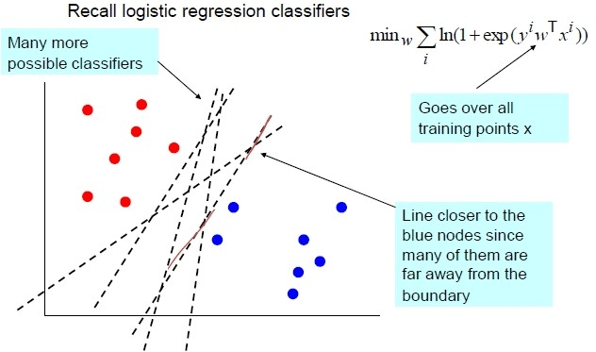
Logistic Regression
(₁
if (w^{T} x + b) ≥ 0
y =
−1 if (w^{T} x + b) < 0

Slide 10
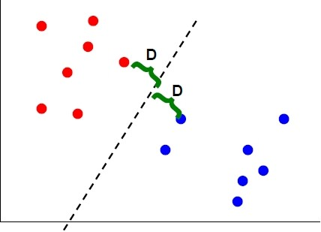
Max Margin Classification
Instead of fitting all the points, focus on the boundary points
Aim: learn a boundary that leads to the largest margin (buffer) from points on both sides
Why: intuition; theoretical support; and works well in practice
Subset of vectors that support (determine boundary) are called the support vectors
5 / 15

Slide 11
Logistic Regression Vs. Support Vector Machine
Depending on the number of features you have you can either choose Logistic Regression or SVM.
SVM works best when the dataset is small and complex.
It is usually advisable to first use logistic regression and see how does it performs, if it fails to give a good accuracy you can go for SVM without any kernel (will talk more about kernels in the later section).
Logistic regression and SVM without any kernel have similar performance but depending on your features, one may be more efficient than the other.

Slide 12
Types of Support Vector Machine
Linear SVM
When the data is perfectly linearly separable only then we can use Linear SVM. Perfectly linearly separable means that the data points can be classified into 2 classes by using a single straight line(if 2D).
Non-Linear SVM
When the data is not linearly separable then we can use Non-Linear SVM, which means when the data points cannot be separated into 2 classes by using a straight line (if 2D) then we use some advanced techniques like kernel tricks to classify them.
In most real-world applications we do not find linearly separable datapoints hence we use kernel trick to solve them.

Slide 13
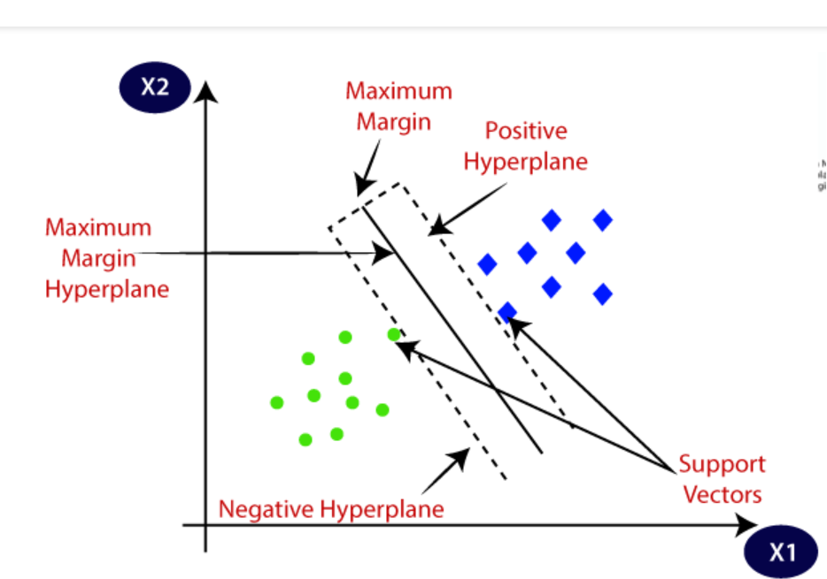
Support Vector Machine
Support Vectors: These are the points that are closest to the hyper-plane. A separating line will be defined with the help of these data points.
Margin: it is the distance between the hyperplane and the observations closest to the hyperplane (support vectors). In SVM large margin is considered a good margin. There are two types of margins hard margin and soft margin.

Slide 14
What Is A Good Decision Boundary?
Consider a two-class, linearly separable classification problem
Many decision boundaries!
The Perceptron algorithm can be used to find such a boundary
Different algorithms have been proposed
Are all decision boundaries equally good?
x2
Class 2
Class 1
x1
Notes:
Perceptron learning rule can be used to find any decision boundary between class 1 and class 2

Slide 15
Bad Decision Boundaries
Class 2
Class 2
Class 1
Class 1

Slide 16
General Input / Output For SVM
Input: set of (input, output) training pair samples; call the input sample features x₁, x₂…x_{n}, and the output result y. Typically, there can be lots of input features x_{i}.
Output: set of weights w (or w_{i}), one for each feature, whose linear combination predicts the value of y. (So far, just like neural nets…)
Important difference: we use the optimization of maximizing the margin (‘street width’) to reduce the number of weights that are nonzero to just a few that correspond to the important features that ‘matter’ in deciding the separating line(hyperplane)…these nonzero weights correspond to the support vectors (because they ‘support’ the separating hyperplane)

Slide 17
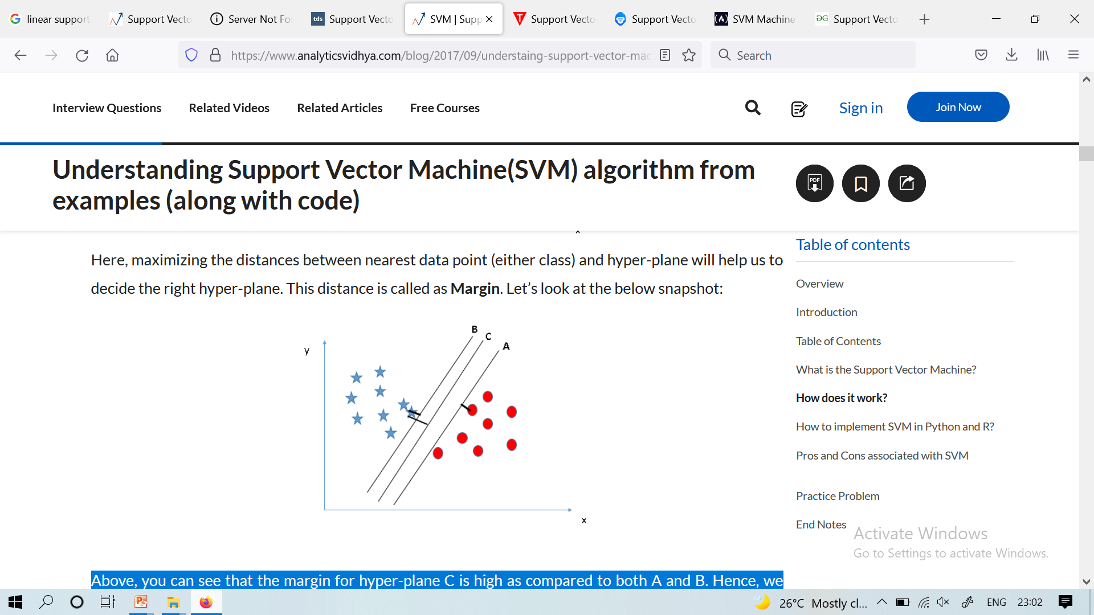
Which Hyperplane to Pick?
Here, maximizing the distances between nearest data point (either class) and hyper-plane will help us to decide the right hyper-plane. This distance is called as Margin.
Above, you can see that the margin for hyper-plane C is high as compared to both A and B. Hence, we name the right hyper-plane as C. Another lightning reason for selecting the hyper-plane with higher margin is robustness. If we select a hyper-plane having low margin then there is high chance of miss-classification.

Slide 18
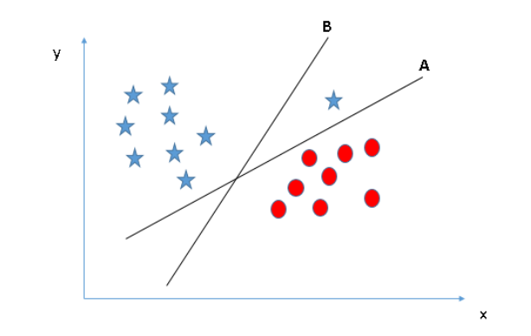
Which Hyperplane to Pick?
Identify the right hyper-plane (Scenario-3)
Some of you may have selected the hyper-plane B as it has higher margin compared to A. But, here is the catch, SVM selects the hyper-plane which classifies the classes accurately prior to maximizing margin. Here, hyper-plane B has a classification error and A has classified all correctly. Therefore, the right hyper-plane is A.

Slide 19
Support Vectors Again For Linearly Separable Case
Support vectors are the elements of the training set that would change the position of the dividing hyperplane if removed.
Support vectors are the critical elements of the training set
The problem of finding the optimal hyper plane is an optimization problem and can be solved by optimization techniques (we use Lagrange multipliers to get this problem into a form that can be solved analytically).

Slide 20




Large-margin Decision Boundary
The decision boundary should be as far away from the data of both classes as possible
We should maximize the margin, m
Class 2
m
Class 1

Slide 21
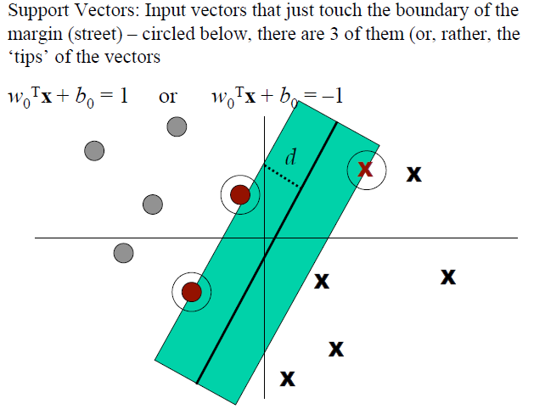
Support Vectors Again For Linearly Separable Case

Slide 22
Some Final Definitions
Margin of Separation (d): the separation between the hyperplane and the closest data point for a given weight vector w and bias b.
Optimal Hyperplane (maximal margin): the particular hyperplane for which the margin of separation d is maximized.

Slide 23




A Geometrical Interpretation
Class 2
α₁₀=0
α₈=0.6
α₇=0
α₂=0
α₅=0
α₁=0.8
α₄=0
α₆=1.4
α₉=0
α₃=0
Class 1
Notes:
So, if change internal points, no effect on the decision boundary

Slide 24
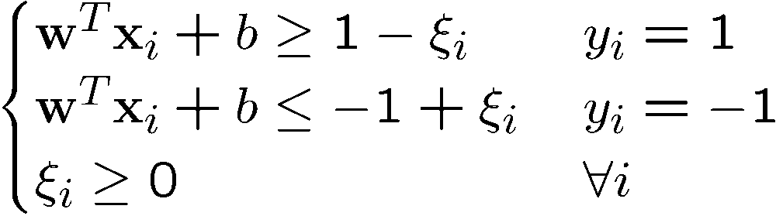
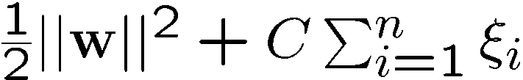
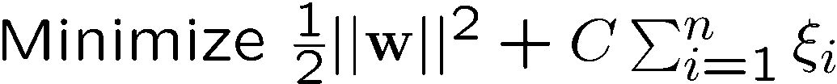
Soft Margin Hyperplane
If we minimize å_{i}x_{i}, x_{i} can be computed by
x_{i} are “slack variables” in optimization
Note that x_{i}=0 if there is no error for x_{i}
x_{i} is an upper bound of the number of errors
We want to minimize
C : tradeoff parameter between error and margin
The optimization problem becomes

Slide 25
SVM Python Implementation
Importing libraries
import pandas as pd
import numpy as np
import matplotlib.pyplot as plt
%matplotlib inline
Importing the Dataset
bankdata = pd.read_csv("https://drive.google.com/file/d/13nw-uRXPY8XIZQxKRNZ3yYlho-CYm_Qt/view")
Data Analysis
bankdata.shape
bankdata.head()
Data Preprocessing
X = bankdata.drop('Class', axis=1)
y = bankdata['Class']
from sklearn.model_selection import train_test_split
X_train, X_test, y_train, y_test = train_test_split(X, y, test_size = 0.20)

Slide 26
SVM Python Implementation
Training the Algorithm
from sklearn.svm import SVC
svclassifier = SVC(kernel='linear')
svclassifier.fit(X_train, y_train)
Making Predictions
y_pred = svclassifier.predict(X_test)
Evaluating the Algorithm
from sklearn.metrics import classification_report, confusion_matrix
print(confusion_matrix(y_test,y_pred))
print(classification_report(y_test,y_pred))

Slide 27
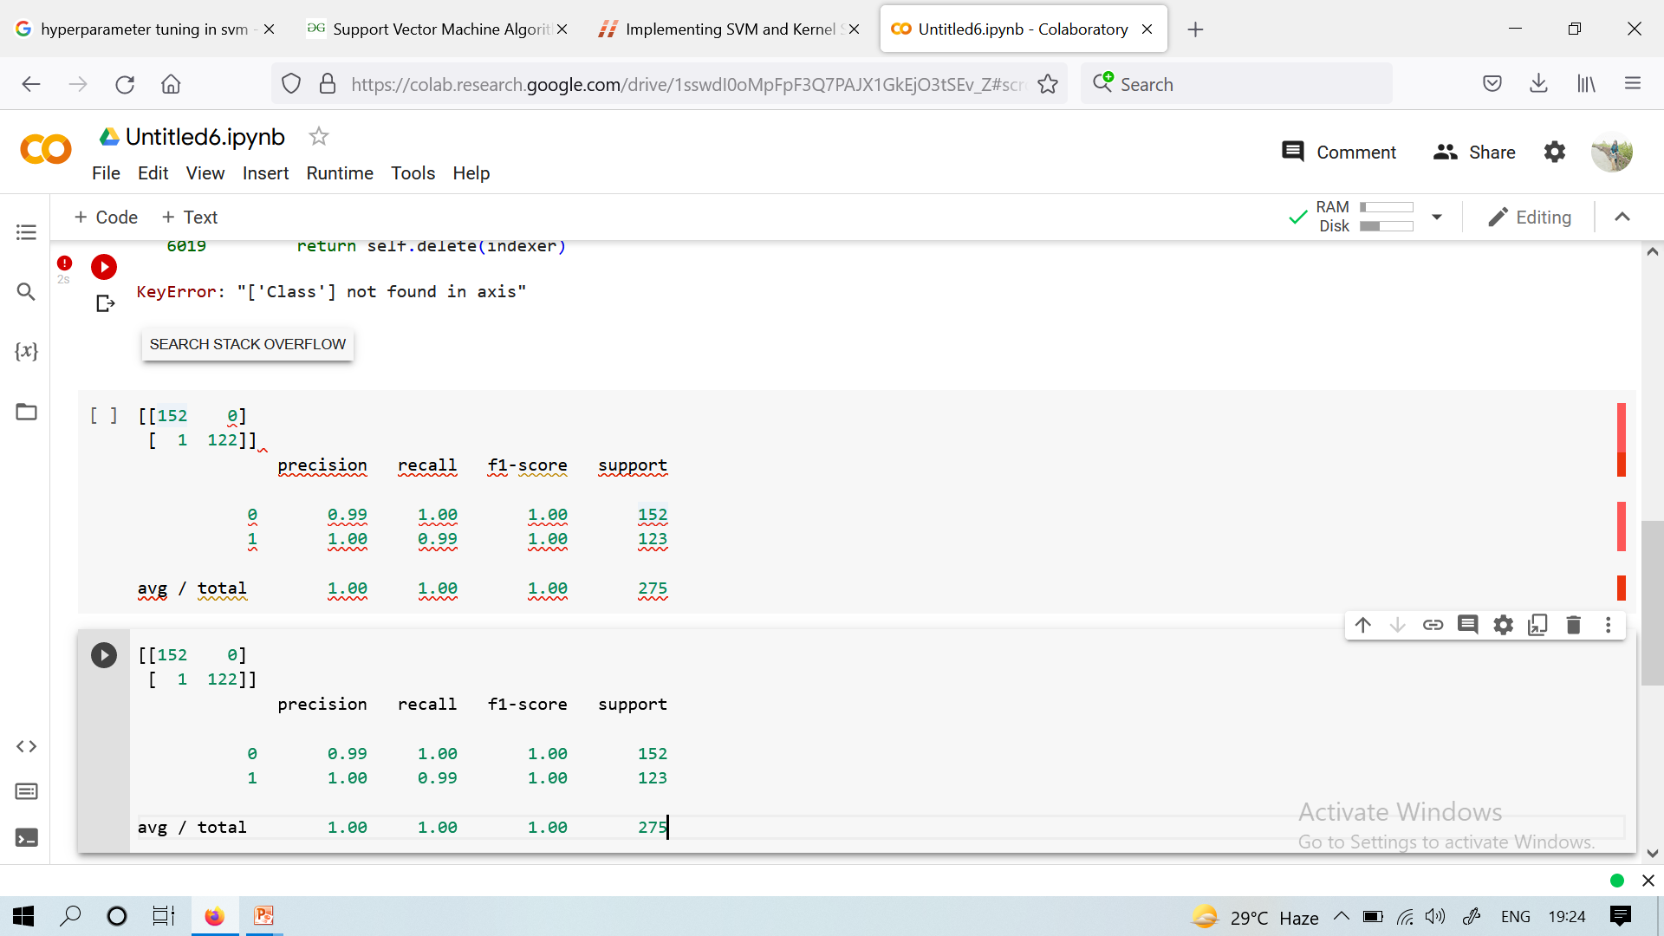
SVM Python Implementation
Results

Slide 28
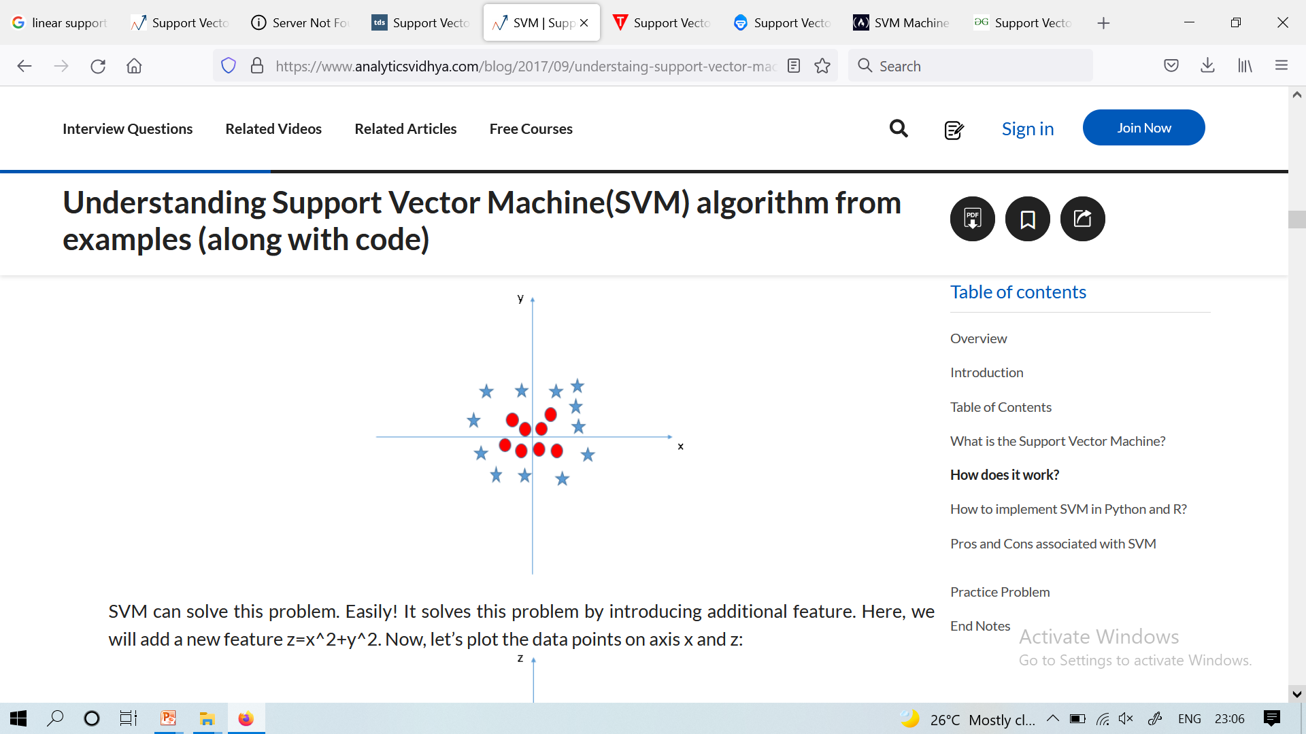
Classify two Classes
Find the hyper-plane to segregate to classes (Scenario-5): In the scenario below, we can’t have linear hyper-plane between the two classes, so how does SVM classify these two classes? Till now, we have only looked at the linear hyper-plane.

Slide 29
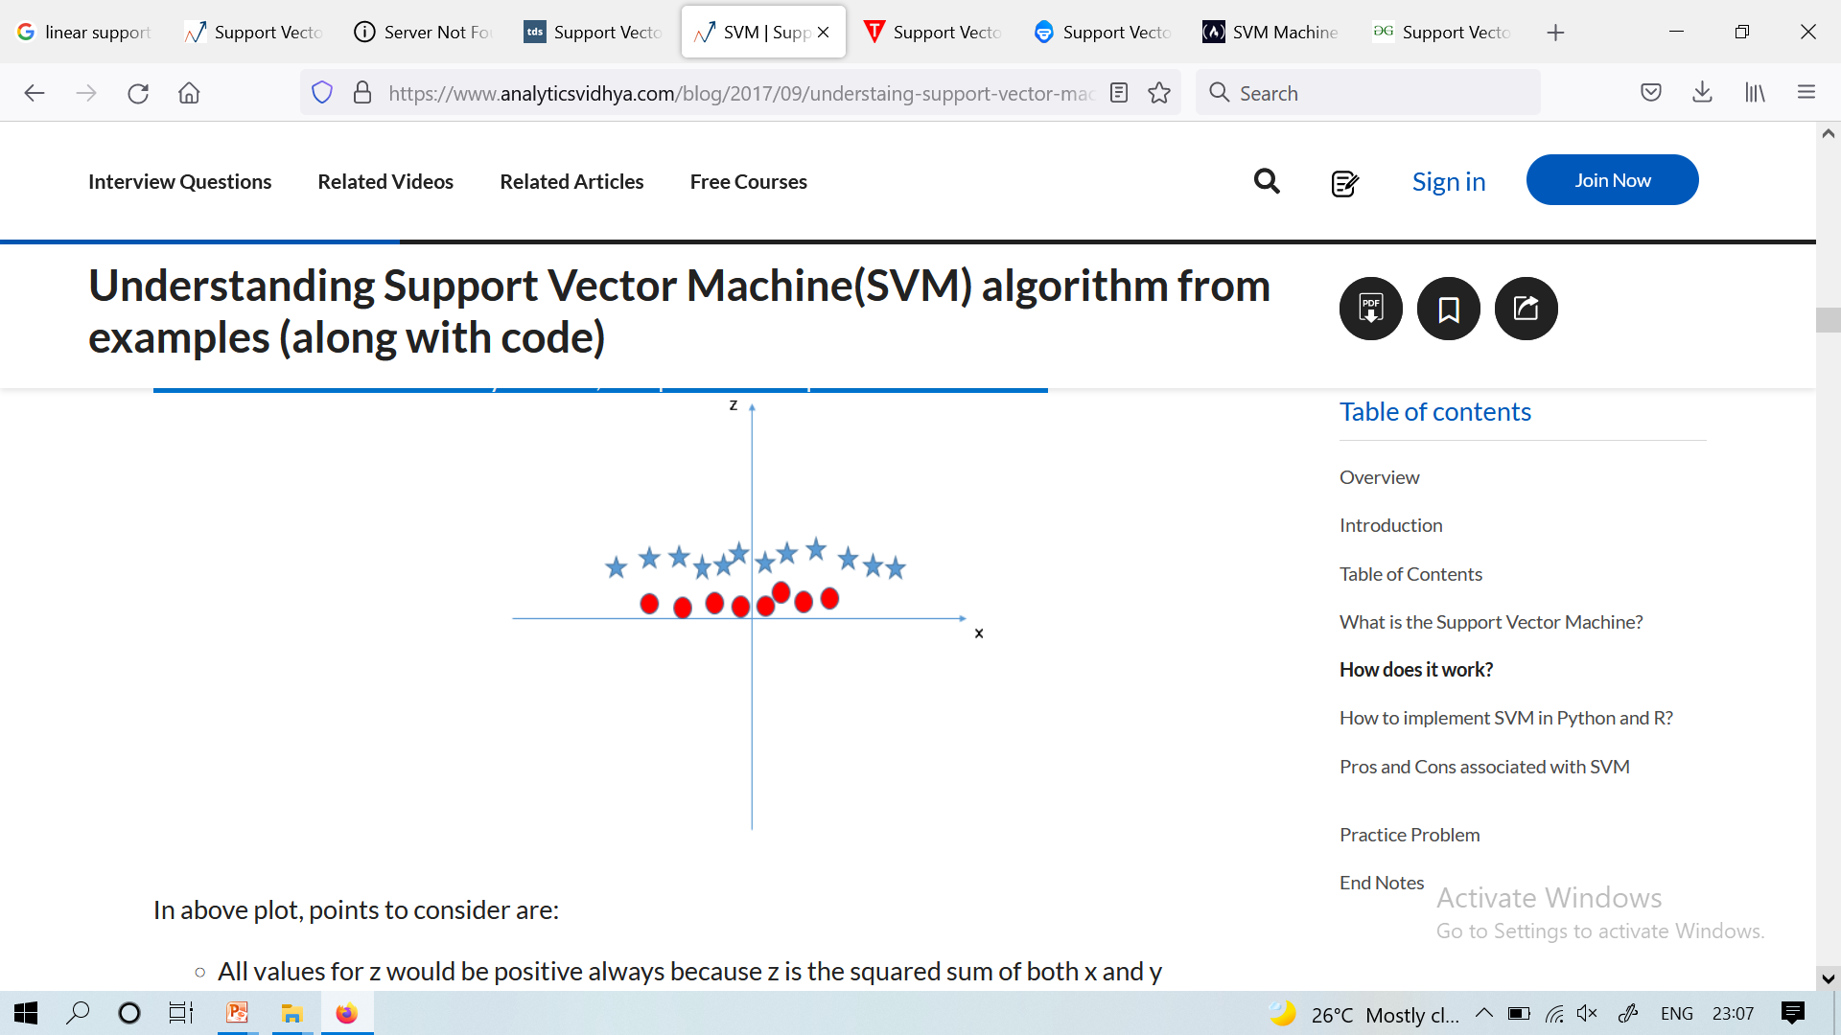
Classify two Classes
SVM can solve this problem. Easily! It solves this problem by introducing additional feature. Here, we will add a new feature z=x^2+y^2. Now, let’s plot the data points on axis x and z:

Slide 30
Classify two Classes
In above plot, points to consider are:
All values for z would be positive always because z is the squared sum of both x and y
In the original plot, red circles appear close to the origin of x and y axes, leading to lower value of z and star relatively away from the origin result to higher value of z.
In the SVM classifier, it is easy to have a linear hyper-plane between these two classes. But, another burning question which arises is, should we need to add this feature manually to have a hyper-plane.

Slide 31
Classify two Classes
No, the SVM algorithm has a technique called the kernel trick.
The SVM kernel is a function that takes low dimensional input space and transforms it to a higher dimensional space i.e. it converts not separable problem to separable problem.
It is mostly useful in non-linear separation problem.
Simply put, it does some extremely complex data transformations, then finds out the process to separate the data based on the labels or outputs you’ve defined.

Slide 32
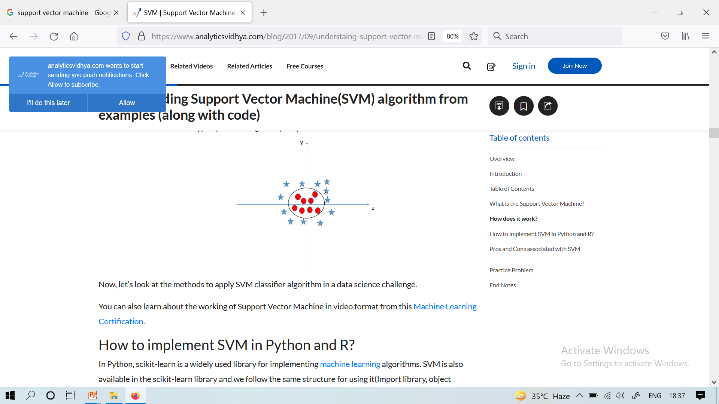
Classify two Classes
When we look at the hyper-plane in original input space it looks like a circle:

Slide 33
Creating Nonlinear Classifiers: Kernel Trick
We use Kernelized SVM for non-linearly separable data.
We can transform one dimensional non linear data into two dimensions and the data will become linearly separable in two dimensions.
This is done by mapping each 1-D data point to a corresponding 2-D ordered pair.
So for any non-linearly separable data in any dimension, we can just map the data to a higher dimension and then make it linearly separable.
A kernel is nothing but a measure of similarity between data points.

Slide 34
SVM Kernel
The SVM kernel is a function that takes low dimensional input space
It transforms it into higher-dimensional space, ie it converts not separable problem to separable problem.
It is mostly useful in non-linear separation problems.
Simply put the kernel, it does some extremely complex data transformations
It finds out the process to separate the data based on the labels or outputs defined.

Slide 35
Suppose we’re in 1-D
Suppose data is like shown in the figure below.
SVM solves this by creating a new variable using a kernel.
We call a point x_{i} on the line and we create a new variable y_{i} as a function of distance from origin o.so if we plot this we get something like as shown below
x=0

Slide 36
Suppose we’re in 1-D
x=0
Positive “plane”
Negative “plane”

Slide 37
Harder 1-D dataset
x=0

Slide 38
Harder 1-D dataset
x=0

Slide 39
Kernel Function
The kernel function in a kernelized SVM tells you, that given two data points in the original feature space, what the similarity is between the points in the newly transformed feature space.
This similarity function, which is mathematically a kind of complex dot product is actually the kernel of a kernelized SVM.
This makes it practical to apply SVM when the underlying feature space is complex or even infinite-dimensional.
Important Parameters in Kernelized SVC ( Support Vector Classifier)
There are various kernel functions available, but 3 are very popular :
Polynomial Kernel
RBF Kernel
Sigmoid Kernel

Slide 40

Examples of Kernel Functions
Polynomial kernel with degree d
Radial basis function kernel with width s
Closely related to radial basis function neural networks
The feature space is infinite-dimensional
Sigmoid with parameter k and q
It does not satisfy the Mercer condition on all k and q
Notes:
Despite violating Mercer condition, the sigmoid kernel function can still work

Slide 41
Examples of Kernel Functions
Kernel | How it Separates Data | Best for
Linear | Straight line/plane | Simple, linearly-separable data
Polynomial | Curved lines/planes | Data that needs curves
RBF/Gaussian | Complex, flexible shapes | Very tangled, tricky data
Sigmoid | S-shaped separation | Rarely used, niche cases

Slide 42
Choosing the Kernel Function
The kernel function is important because it creates the kernel matrix, which summarizes all the data
Many principles have been proposed (diffusion kernel, Fisher kernel, string kernel, …)
There is even research to estimate the kernel matrix from available information
In practice, a low degree polynomial kernel or RBF kernel with a reasonable width is a good initial try
Note that SVM with RBF kernel is closely related to RBF neural networks, with the centers of the radial basis functions automatically chosen for SVM

Slide 43
Advantages of SVM
They are versatile: different kernel functions can be specified, or custom kernels can also be defined for specific data types.
They work well for both high and low dimensional data.
SVM works better when the data is Linear and it is more effective in high dimensions
With the help of the kernel trick, we can solve any complex problem
SVM is not sensitive to outliers
Can help us with Image classification
No local optimal, unlike in neural networks
Tradeoff between classifier complexity and error can be controlled explicitly
Non-traditional data like strings and trees can be used as input to SVM, instead of feature vectors

Slide 44
Disadvantages of SVM
Efficiency (running time and memory usage) decreases as the size of the training set increases.
Needs careful normalization of input data and parameter tuning.
Does not provide a direct probability estimator.
Difficult to interpret why a prediction was made.
Choosing a good kernel is not easy
It doesn’t show good results on a big dataset
The SVM hyper-parameters are Cost -C and gamma.
It is not that easy to fine-tune these hyper-parameters.
It is hard to visualize their impact

